Slide 1
Preparing for winter
Tom Pankonen
Honey Pimp Aparies

Slide 2
The basics
Preparing for winter begins mid to late summer!
Healthy colony
Plenty of quality food
Prevent moisture
Ventilation
Critters

Slide 3
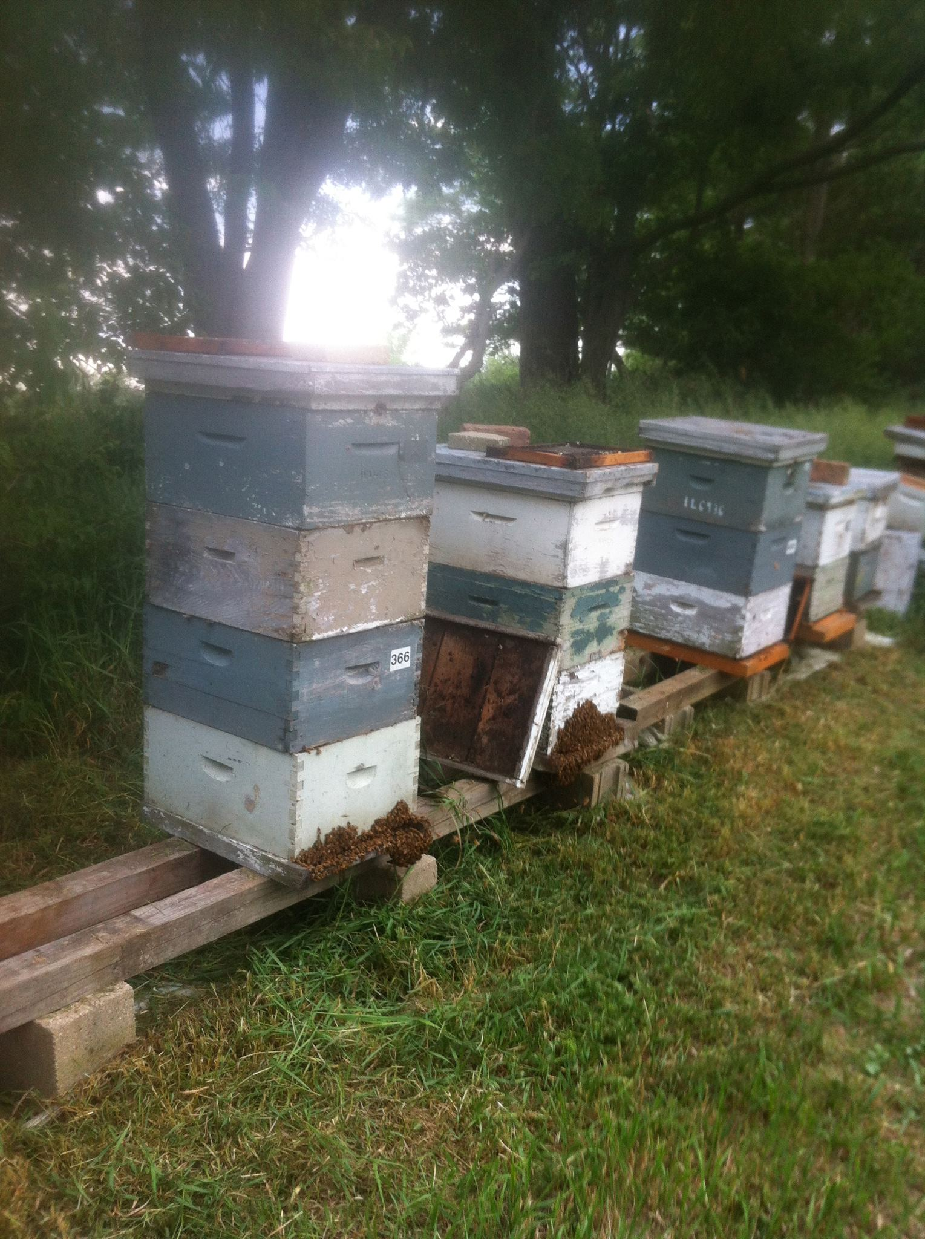
What’s wrong here?

Slide 4
Consolidate
Reduce the hive to the essentials
If the hive is light, DON’T HARVEST!
If it’s still light, FEED!
Think about consolidating week hives

Slide 5
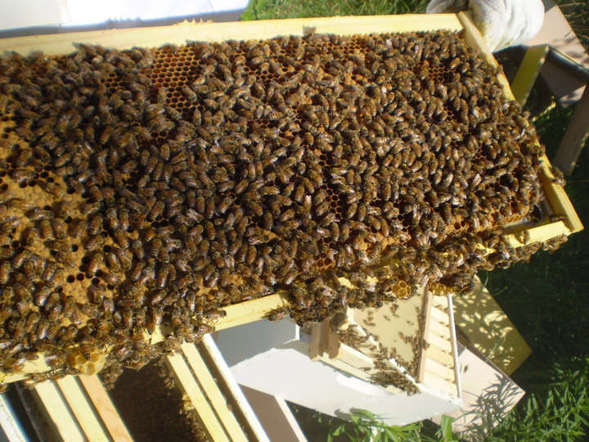
Plenty Of bees

Slide 6
Plenty of bees
Ensures a healthy queen laying eggs
Plenty of workers to bring in pollen for winter brood rearing and stores
The more bees the easier it is to fill deeps and supers with honey for feeding

Slide 7
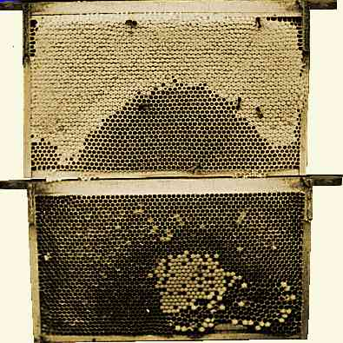
Brood patterns
agdev.anr.udel.edu

Slide 8
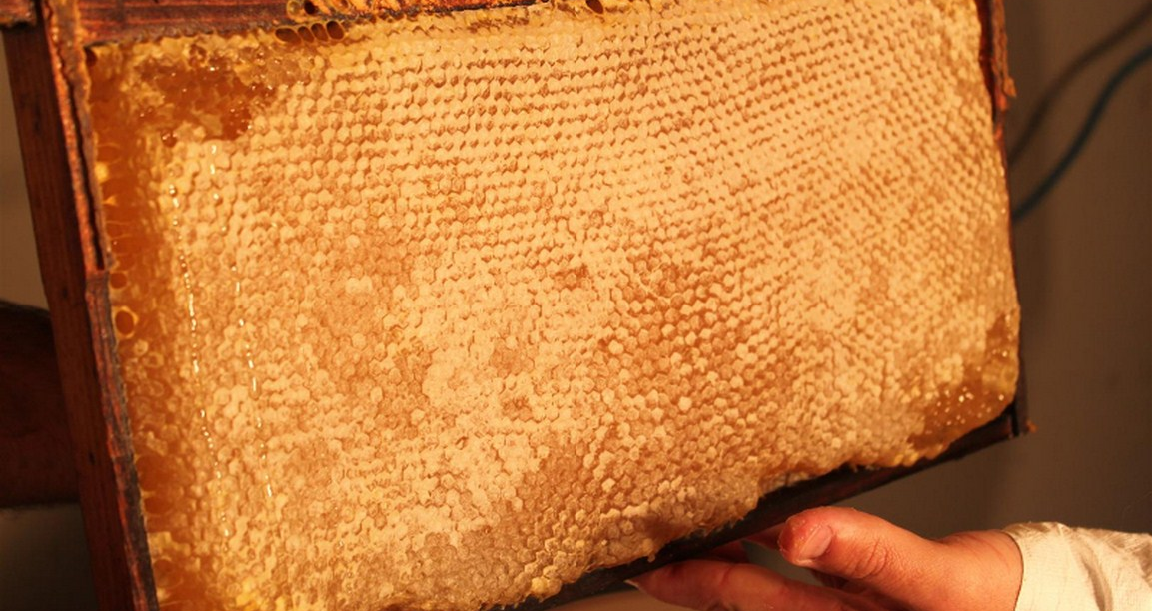
Plenty of honey
indyurbanbeekeeping.org

Slide 9
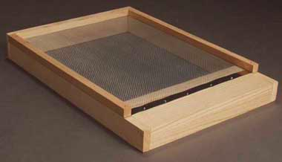
Screened bottom board
Dadant.com

Slide 10
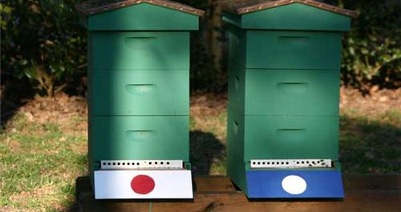
Reduce the entrance
meckbees.org

Slide 11
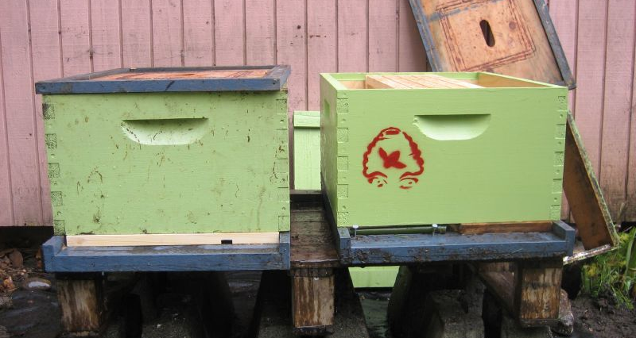
incorrect
hive-mind.com

Slide 12
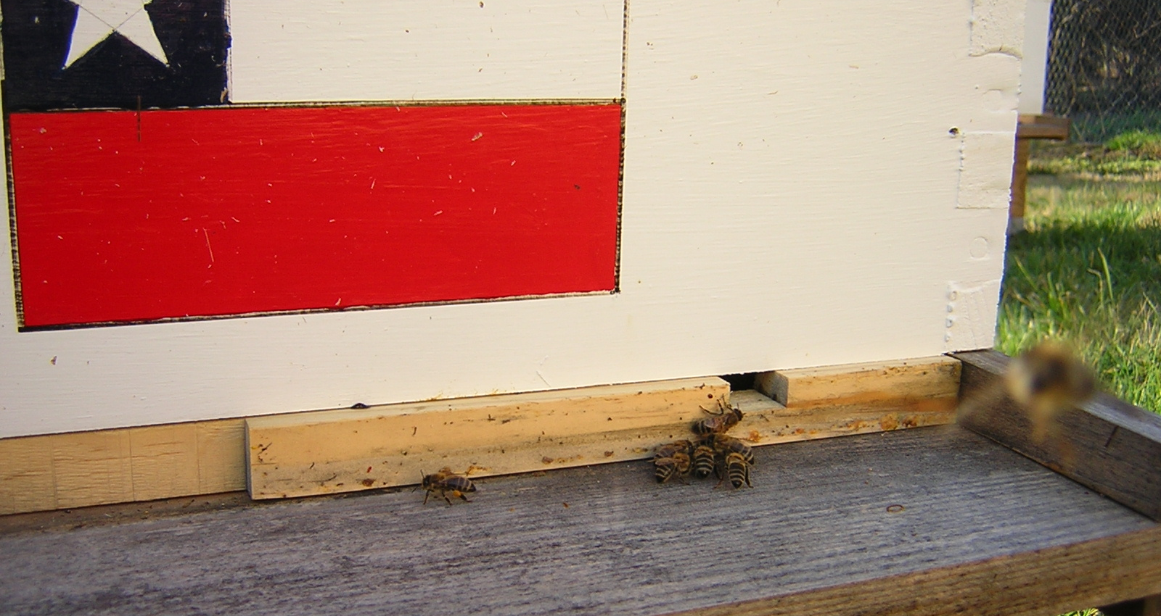
meckbees.org

Slide 13
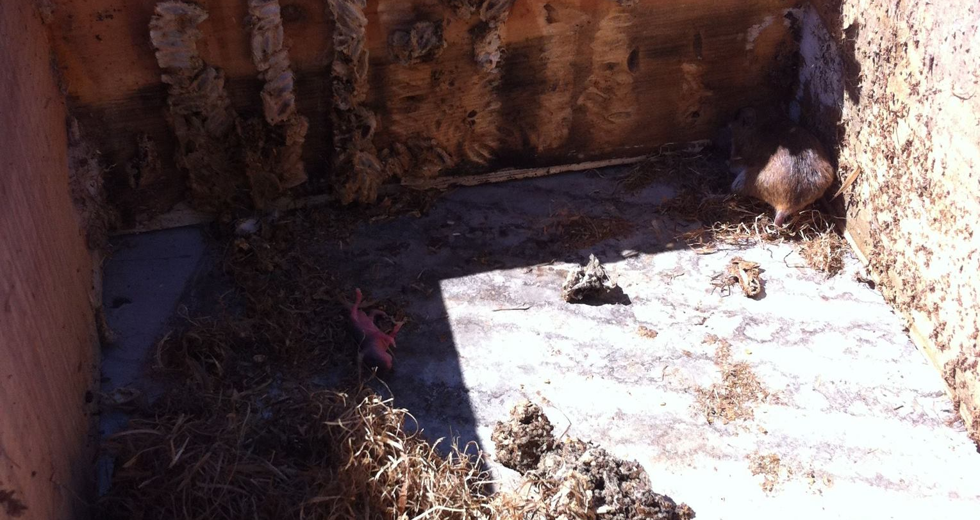
Critters and pests

Slide 14
WRAPPING
PROS
  Reduces drafts
  Provides dark color to absorb sunlight
Cons
  Reduces ventilation
  Warms the hive to the point the bees think its warm out
  Can shift and block entrances

Slide 15
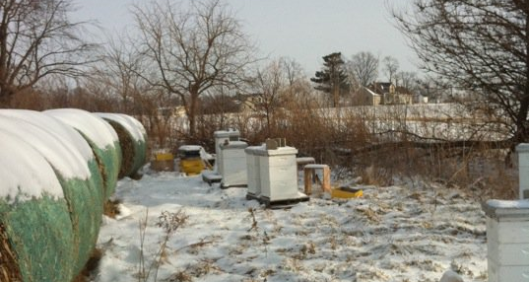
Wind blocks

